Slide 1
UNIT 2
DESIGN AND NORMALIZATION

Slide 2
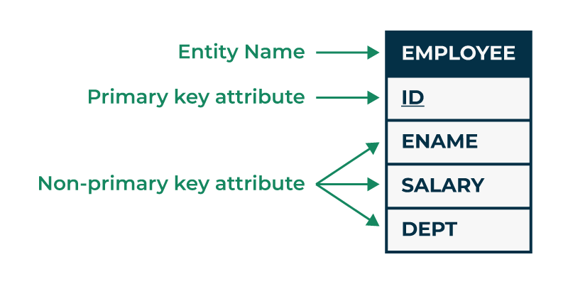
Entity in DBMS
An entity in DBMS represents a real-world object or concept that can be uniquely identified and stored in a database.
An entity is a person, place, object, event, or concept that exists independently and has attributes.

Slide 3
The Entity-Relationship Model (ER Model)
The Entity-Relationship Model (ER Model) is a conceptual model for designing a database.
This model represents the logical structure of a database, including entities, their attributes, and relationships between them.
Entity: An object that is stored as data.
E.g: Student, Course, or Company.
Attribute: Properties that describe an entity.
E.g: StudentID, CourseName, or EmployeeEmail.
Relationship: A connection between entities.
E.g: Student enrolls in a Course.

Slide 4
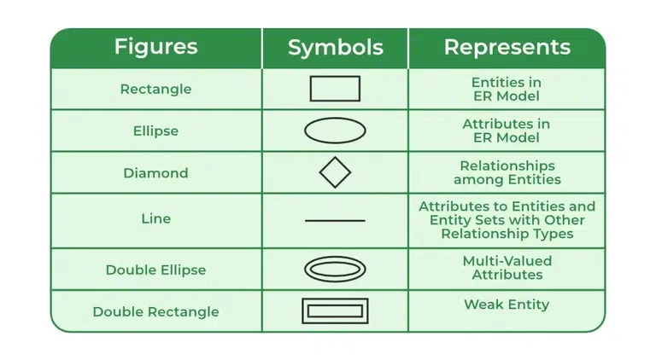
Symbols Used in ER Model

Slide 5
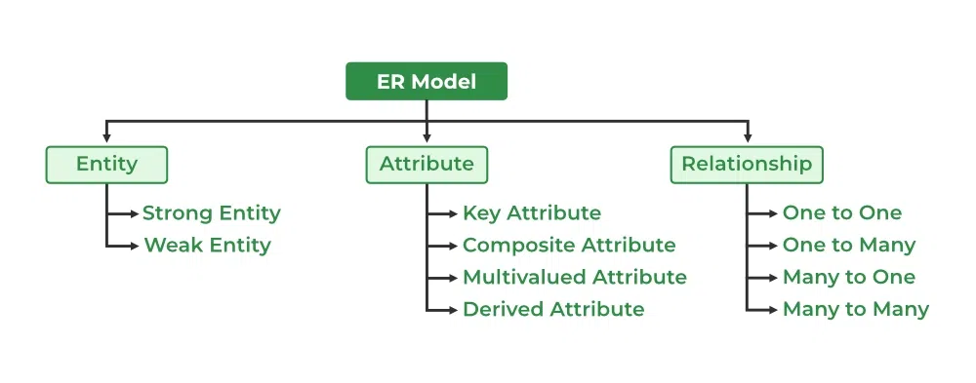

Slide 6
Types of Entity
Strong Entity:
A strong entity is not dependent on any other entity in the schema.
A strong entity will always have a primary key.
Strong entities are represented by a single rectangle.
Relationship of two strong entities is represented by a single diamond.
Weak Entity
A weak entity is dependent on a strong entity.
Weak entity does not have any primary key.
A weak entity is represented by a double rectangle.
The relation between one strong and one weak entity is represented by a double diamond.

Slide 7
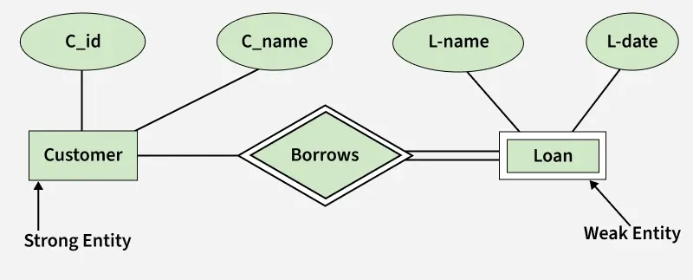

Slide 8
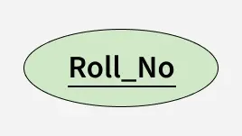
Types of Attributes
Key Attribute:
The attribute which uniquely identifies each entity in the entity set is called the key attribute.
For example, Roll_No will be unique for each student.
In ER diagram, the key attribute is represented by an oval with an underline.

Slide 9
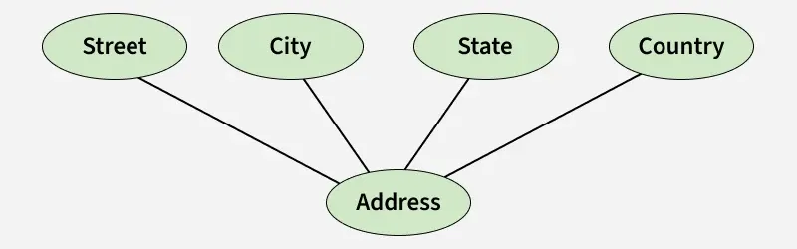
Composite Attribute
An attribute composed of many other attributes is called a composite attribute.
For example, the Address attribute of the student Entity type consists of Street, City, State, and Country.
In ER diagram, the composite attribute is represented by an oval comprising of ovals.

Slide 10
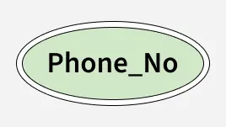
Multivalued Attribute
An attribute consisting of more than one value for a given entity.
For example, Phone_No (can be more than one for a given student).
In ER diagram, a multivalued attribute is represented by a double oval.

Slide 11
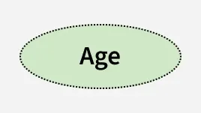
Derived Attribute
An attribute that can be derived from other attributes of the entity type is known as a derived attribute.
e.g.; Age (can be derived from DOB).
In ER diagram, the derived attribute is represented by a dashed oval.

Slide 12
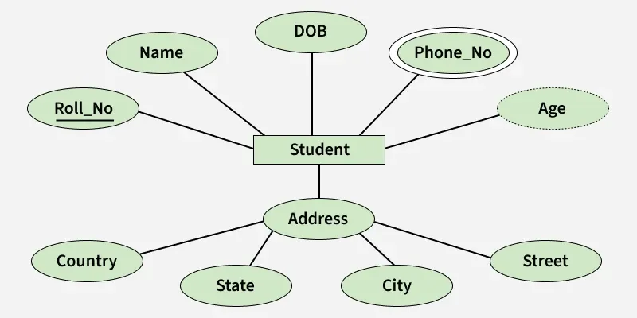

Slide 13
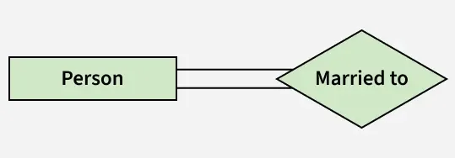
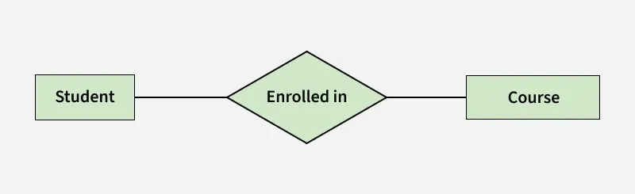
Degree of a Relationship Set
Unary/Recursive Relationship: When there is only ONE entity set participating in a relation, the relationship is called a unary relationship. For example, one person is married to only one person.
Binary Relationship:
When there are TWO entities set participating in a relationship, the relationship is called a binary relationship. For example, a Student is enrolled in a Course.

Slide 14
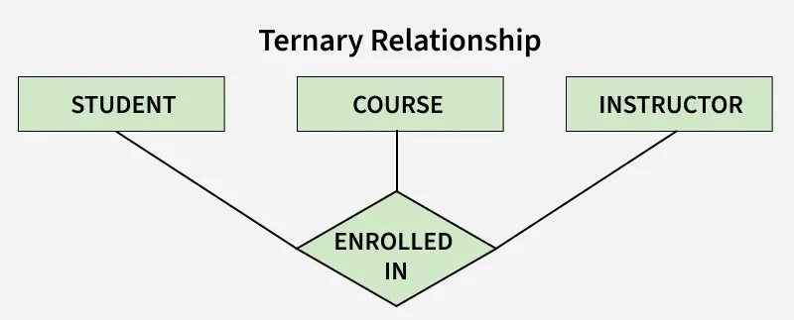
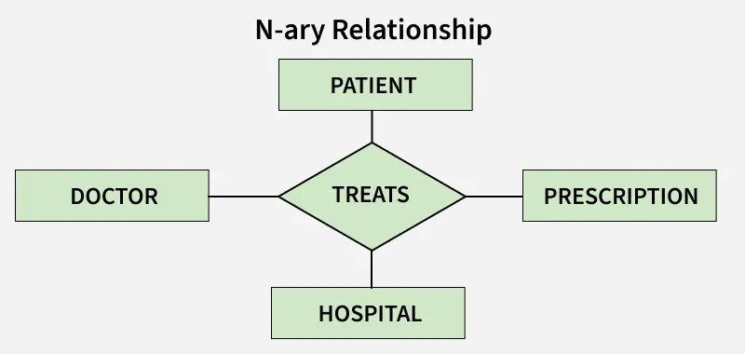
Ternary Relationship: When there are three entity sets participating in a relationship, the relationship is called a ternary relationship.
N-ary Relationship: When there are n entities set participating in a relationship, the relationship is called an n-ary relationship.

Slide 15
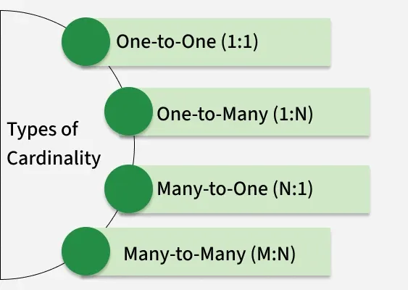
Cardinality in DBMS
Cardinality refers to the number of tubles in a table is called cardinality.

Slide 16
Mapping Cardinality
Denotes the number of entities to which another entity can be linked through a relationship.
One-to-One
One-to-Many
Many-to-One
Many-to-Many

Slide 17
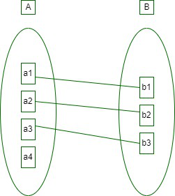
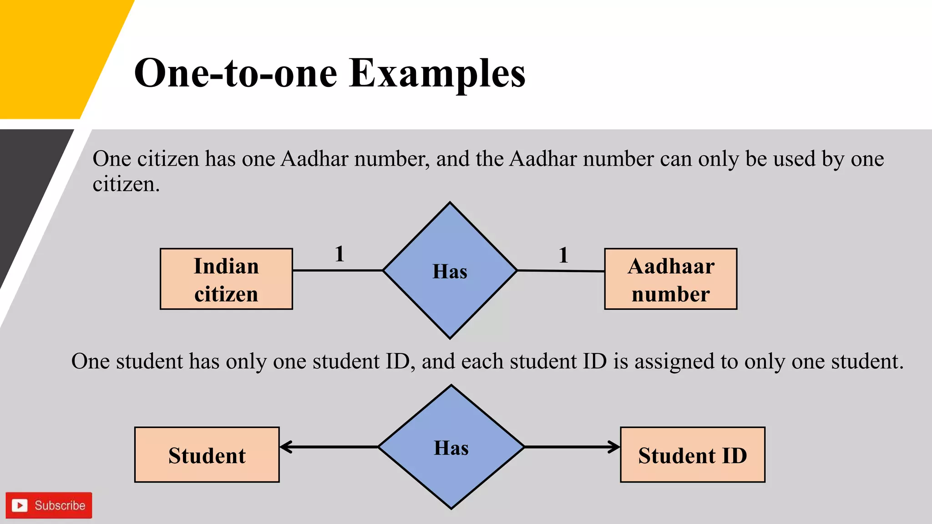
One-to-One
Entity in A is connected to at most one entity in B.

Slide 18
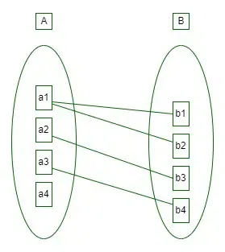
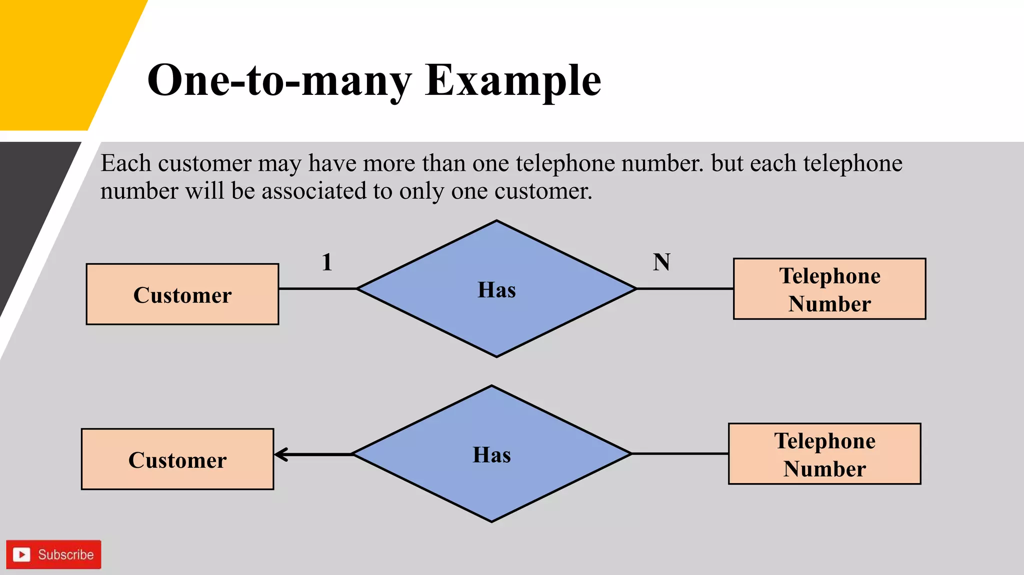
One-to-Many
An entity in A is associated with any number of entities in B.

Slide 19
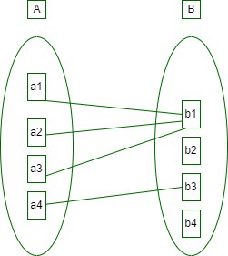
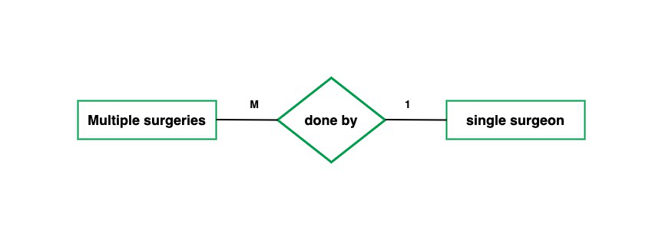
Many-to-One
Elements in B can be associated with any number (zero or more) of entities or elements in A.

Slide 20
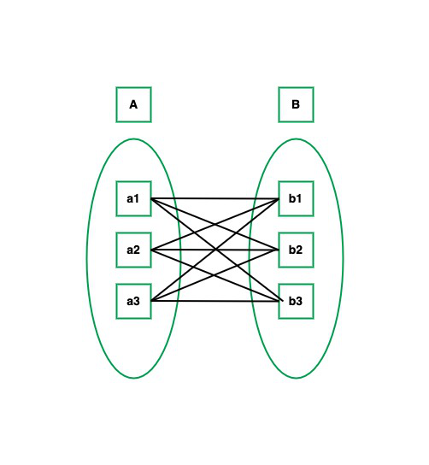
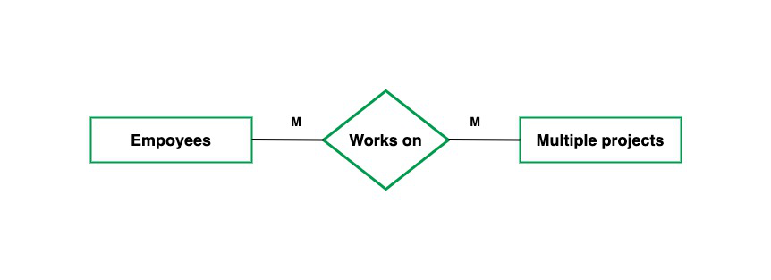
Many-to-Many
An entity in A is associated with any number of entities in B, and an entity in B is associated with any number of entities in A.

Slide 21
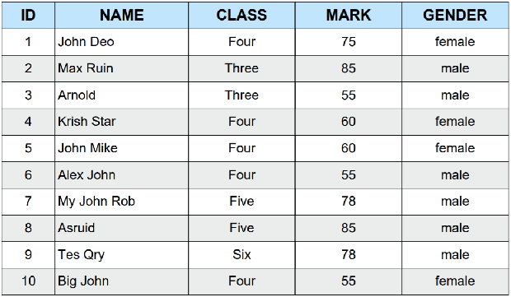

Slide 22
Enhanced-ER Model
The Enhanced ER (EER) Model is an extension of the traditional ER model.
In the Enhanced ER (EER) Model, several advanced concepts are used to represent complex data relationships, inheritance, and abstraction in databases.

Slide 23
In addition to ER model concepts EE-R includes
• Subclasses and Super classes.
• Specialization and Generalization.
• Category or union type.
• Aggregation.

Slide 24
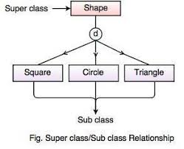
Subclasses and Super class
Super class is an entity that can be divided into further subtype.
For example − consider Shape super class.

Slide 25
Specialization is a process of identifying subsets of an entity that share some different characteristic. It is a top down approach in which one entity is broken down into low level entity.
Example :person into employee or student.

Slide 26
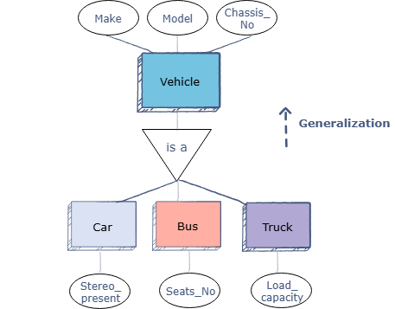
Specialization and Generalization
Generalization is a bottom-up abstraction process where multiple entity types with common characteristics are combined into a higher-level, generalized entity type (superclass).

Slide 27
Constraints on Generalizations
Disjoint
A dis jointness constraint requires that an entity belong to no more than one lower-level entity set.
Overlapping
In overlapping generalizations, the same entity may belong to more than one lower-level entity set within a single generalization.

Slide 28
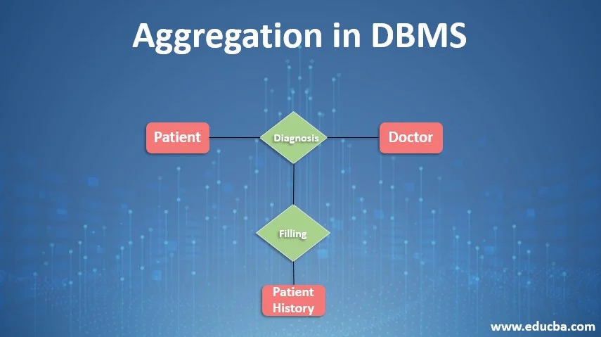
Aggregation
Represents relationship between a whole object and its component.

Slide 29
Types of Functional dependencies in DBMS
Functional dependency is a concept that specifies the relationship between two sets of attributes where one attribute determines the value of another attribute.
It is denoted as X → Y, where the attribute set on the left side of the arrow, X is called Determinant, and Y is called the Dependent.

Slide 30
Example:
Valid functional dependencies:
rollno → { name, deptname, deptbuilding }→ Here, roll_no can determine values of fields name, dept_name and dept_building, hence a valid Functional dependency
rollno → dept_name , Since, roll_no can determine whole set of {name, dept_name, dept_building}, it can determine its subset dept_name also.
dept_name → dept_building , Dept_name can identify the dept_building accurately.
roll_no | name | dept_name | dept_building
42 | abc | CO | A4
43 | pqr | IT | A3
44 | xyz | CO | A4
45 | xyz | IT | A3
46 | mno | EC | B2
47 | jkl | ME | B2
Invalid functional dependencies:
name → dept_name Students with the same name can have different dept_name, hence this is not a valid functional dependency.
dept_building → dept_name There can be multiple departments in the same building. Example, in the above table departments ME and EC are in the same building B2, hence dept_building → dept_name is an invalid functional dependency.

Slide 31
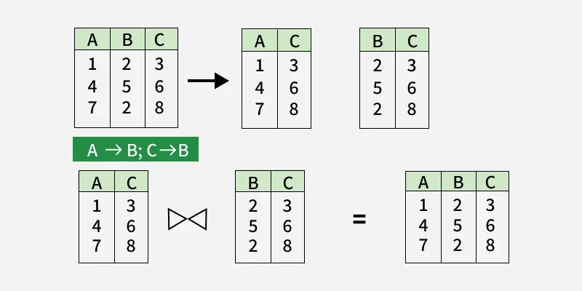
Lossless Decomposition in DBMS
A lossless decomposition is a process of decomposing a relation schema into multiple relations in such a way that it preserves the information contained in the original relation.

